Slide 1


Data-Intensive Distributed Computing
CS 431/631 451/651 (Winter 2019)
Part 9: Real-Time Data Analytics (2/2)
April 2, 2019
Adam Roegiest
Kira Systems
These slides are available at http://roegiest.com/bigdata-2019w/
This work is licensed under a Creative Commons Attribution-Noncommercial-Share Alike 3.0 United States See http://creativecommons.org/licenses/by-nc-sa/3.0/us/ for details

Slide 2
Since last time…
Storm/Heron
Gives you pipes, but you gotta connect everything up yourself
Spark Streaming
Gives you RDDs, transformations and windowing –
but no event/processing time distinction
Beam
Gives you transformations and windowing, event/processing time distinction –
but too complex

Slide 3
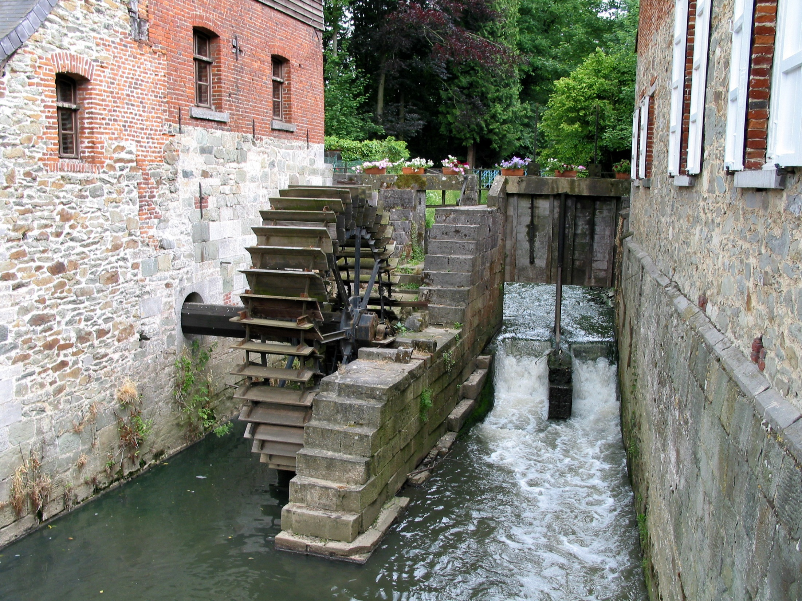
Spark Structured Streaming
Stream Processing Frameworks
Source: Wikipedia (River)

Slide 4
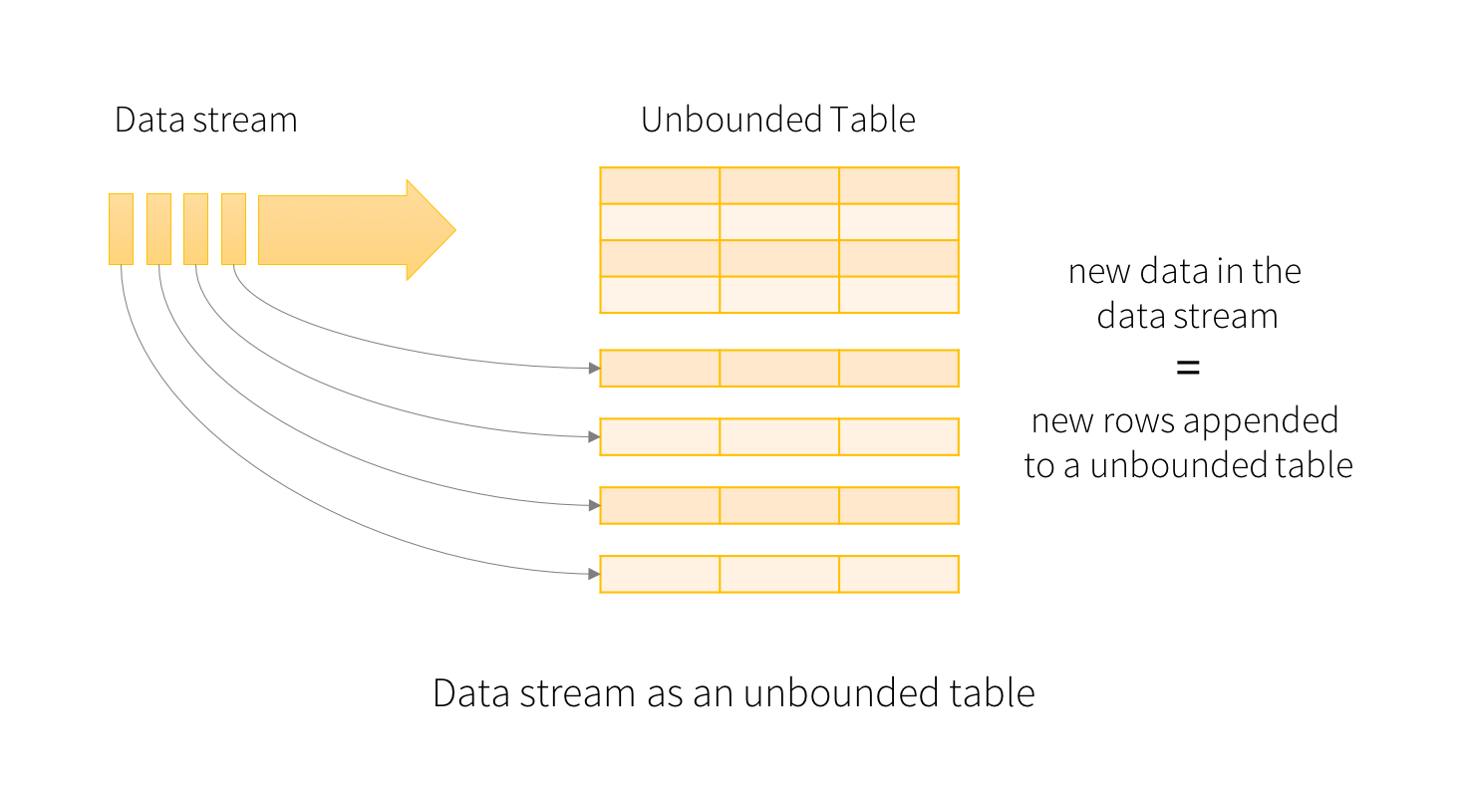
Step 1: From RDDs to DataFrames
Step 2: From bounded to unbounded tables
Source: Spark Structured Streaming Documentation

Slide 5
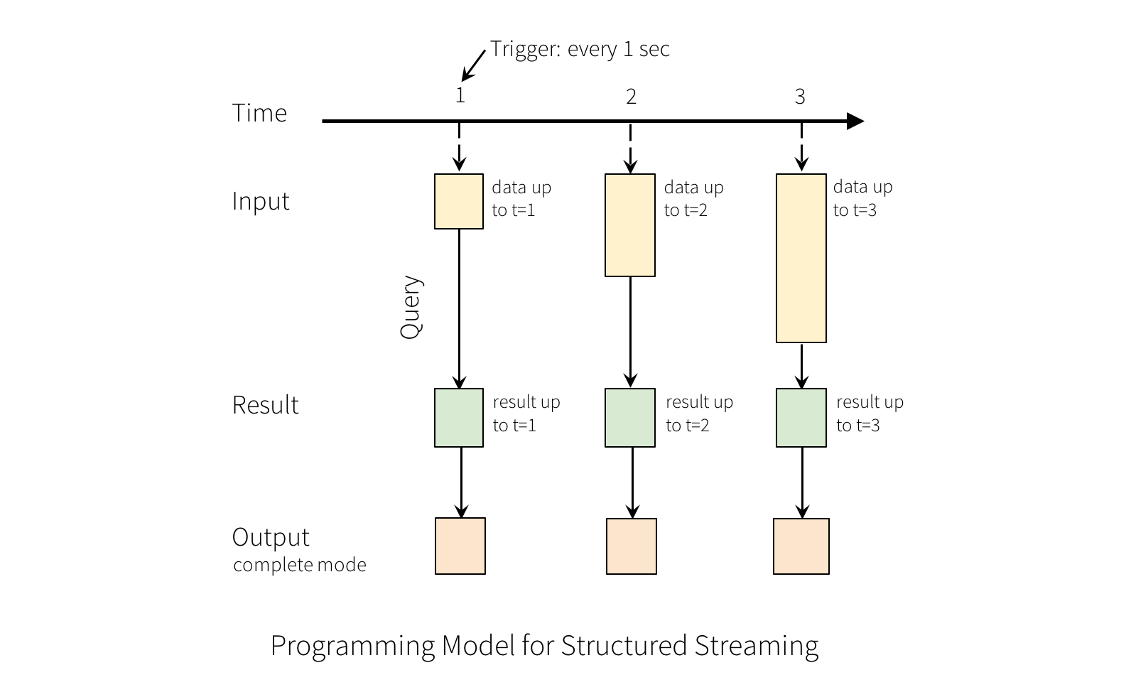
Source: Spark Structured Streaming Documentation

Slide 6
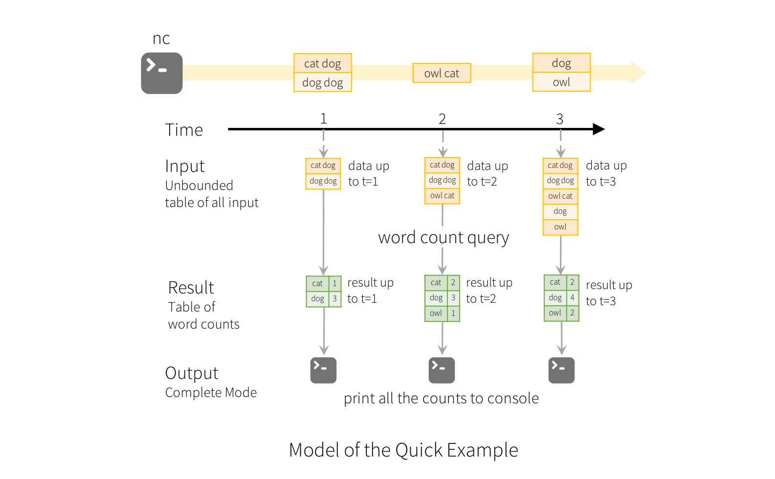
Source: Spark Structured Streaming Documentation

Slide 7
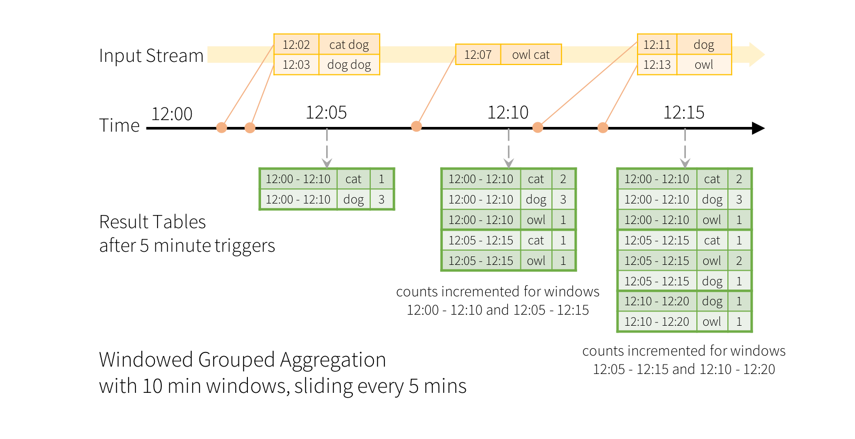
Source: Spark Structured Streaming Documentation

Slide 8
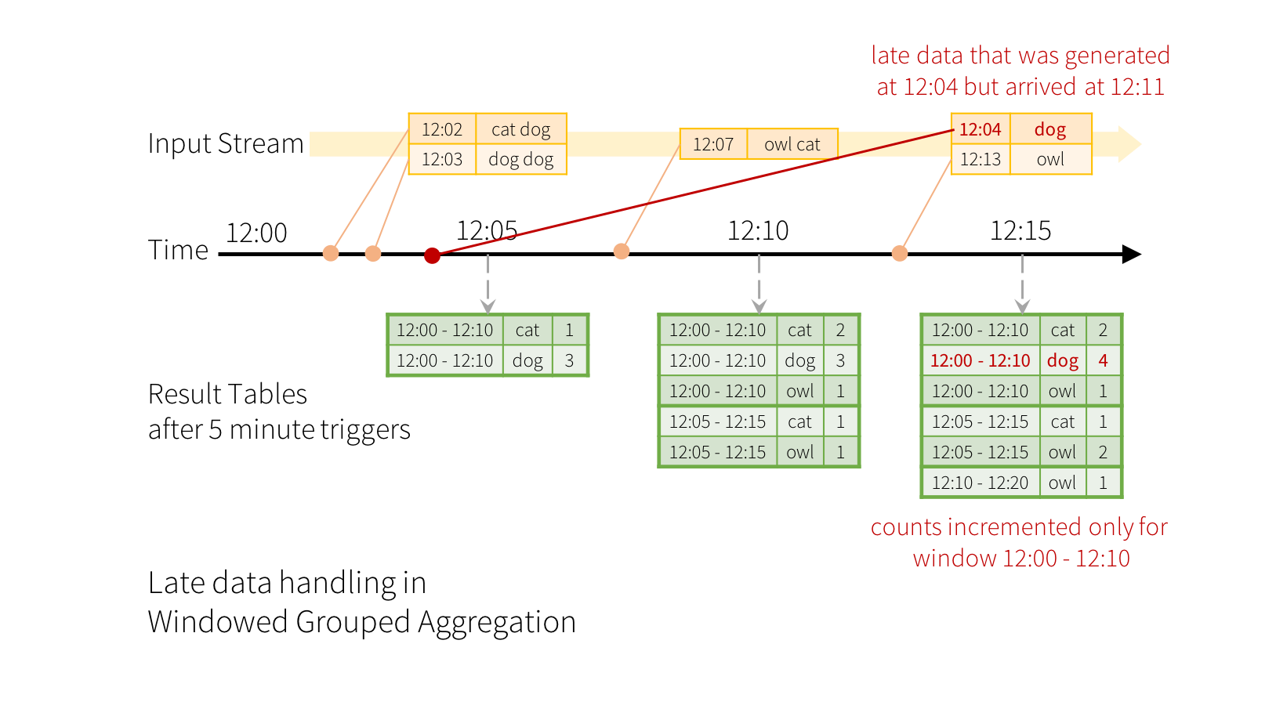
Source: Spark Structured Streaming Documentation

Slide 9
Interlude
Source: Wikipedia (River)

Slide 10
Streams Processing Challenges
Inherent challenges
Latency requirements
Space bounds
System challenges
Bursty behavior and load balancing
Out-of-order message delivery and non-determinism
Consistency semantics (at most once, exactly once, at least once)

Slide 11
Algorithmic Solutions
Throw away data
Sampling
Accepting some approximations
Hashing

Slide 12
Reservoir Sampling
Task: select s elements from a stream of size N with uniform probability
N can be very very large
We might not even know what N is! (infinite stream)
Solution: Reservoir sampling
Store first s elements
For the k-th element thereafter, keep with probability s/k (randomly discard an existing element)
Example: s = 10
Keep first 10 elements
11th element: keep with 10/11
12th element: keep with 10/12
…

Slide 13
Reservoir Sampling: How does it work?
Example: s = 10
Keep first 10 elements
11th element: keep with 10/11
If we decide to keep it: sampled uniformly by definition
probability existing item is discarded: 10/11 × 1/10 = 1/11
probability existing item survives: 10/11
General case: at the (k + 1)th element
Probability of selecting each item up until now is s/k
Probability existing item is discarded: s/(k+1) × 1/s = 1/(k + 1)
Probability existing item survives: k/(k + 1)
Probability each item survives to (k + 1)th round: (s/k) × k/(k + 1) = s/(k + 1)

Slide 14
Hashing for Three Common Tasks
Cardinality estimation
What’s the cardinality of set S?
How many unique visitors to this page?
HashSet
HLL counter
Set membership
Is x a member of set S?
Has this user seen this ad before?
HashSet
Bloom Filter
Frequency estimation
How many times have we observed x?
How many queries has this user issued?
HashMap
CMS

Slide 15
HyperLogLog Counter
Task: cardinality estimation of set
size() → number of unique elements in the set
Observation: hash each item and examine the hash code
On expectation, 1/2 of the hash codes will start with 0
On expectation, 1/4 of the hash codes will start with 00
On expectation, 1/8 of the hash codes will start with 000
On expectation, 1/16 of the hash codes will start with 0000
…
How do we take advantage of this observation?

Slide 16
Bloom Filters
Task: keep track of set membership
put(x) → insert x into the set
contains(x) → yes if x is a member of the set
Components
m-bit bit vector
k hash functions: h₁ … h_{k}
0
0
0
0
0
0
0
0
0
0
0
0

Slide 17
Bloom Filters: put
put
x
h₁(x) = 2
h₂(x) = 5
h₃(x) = 11
0
0
0
0
0
0
0
0
0
0
0
0

Slide 18
Bloom Filters: put
put
x
0
1
0
0
1
0
0
0
0
0
1
0

Slide 19
Bloom Filters: contains
contains
x
h₁(x) = 2
h₂(x) = 5
h₃(x) = 11
0
1
0
0
1
0
0
0
0
0
1
0

Slide 20
Bloom Filters: contains
contains
x
h₁(x) = 2
h₂(x) = 5
h₃(x) = 11
A[h₁(x)]
A[h₂(x)]
AND = YES
A[h₃(x)]
0
1
0
0
1
0
0
0
0
0
1
0

Slide 21
Bloom Filters: contains
contains
y
h₁(y) = 2
h₂(y) = 6
h₃(y) = 9
0
1
0
0
1
0
0
0
0
0
1
0

Slide 22
Bloom Filters: contains
contains
y
h₁(y) = 2
h₂(y) = 6
h₃(y) = 9
A[h₁(y)]
A[h₂(y)]
AND = NO
A[h₃(y)]
0
1
0
0
1
0
0
0
0
0
1
0
What’s going on here?

Slide 23
Bloom Filters
Error properties: contains(x)
False positives possible
No false negatives
Usage
Constraints: capacity, error probability
Tunable parameters: size of bit vector m, number of hash functions k

Slide 24
Count-Min Sketches
Task: frequency estimation
put(x) → increment count of x by one
get(x) → returns the frequency of x
Components
m by k array of counters
k hash functions: h₁ … h_{k}
m
0
0
0
0
0
0
0
0
0
0
0
0
0
0
0
0
0
0
0
0
0
0
0
0
k
0
0
0
0
0
0
0
0
0
0
0
0
0
0
0
0
0
0
0
0
0
0
0
0

Slide 25
Count-Min Sketches: put
put
x
h₁(x) = 2
h₂(x) = 5
h₃(x) = 11
h₄(x) = 4
0
0
0
0
0
0
0
0
0
0
0
0
0
0
0
0
0
0
0
0
0
0
0
0
0
0
0
0
0
0
0
0
0
0
0
0
0
0
0
0
0
0
0
0
0
0
0
0

Slide 26
Count-Min Sketches: put
put
x
0
1
0
0
0
0
0
0
0
0
0
0
0
0
0
0
1
0
0
0
0
0
0
0
0
0
0
0
0
0
0
0
0
0
1
0
0
0
0
1
0
0
0
0
0
0
0
0

Slide 27
Count-Min Sketches: put
put
x
h₁(x) = 2
h₂(x) = 5
h₃(x) = 11
h₄(x) = 4
0
1
0
0
0
0
0
0
0
0
0
0
0
0
0
0
1
0
0
0
0
0
0
0
0
0
0
0
0
0
0
0
0
0
1
0
0
0
0
1
0
0
0
0
0
0
0
0

Slide 28
Count-Min Sketches: put
put
x
0
2
0
0
0
0
0
0
0
0
0
0
0
0
0
0
2
0
0
0
0
0
0
0
0
0
0
0
0
0
0
0
0
0
2
0
0
0
0
2
0
0
0
0
0
0
0
0

Slide 29
Count-Min Sketches: put
put
y
h₁(y) = 6
h₂(y) = 5
h₃(y) = 12
h₄(y) = 2
0
2
0
0
0
0
0
0
0
0
0
0
0
0
0
0
2
0
0
0
0
0
0
0
0
0
0
0
0
0
0
0
0
0
2
0
0
0
0
2
0
0
0
0
0
0
0
0

Slide 30
Count-Min Sketches: put
put
y
0
2
0
0
0
1
0
0
0
0
0
0
0
0
0
0
3
0
0
0
0
0
0
0
0
0
0
0
0
0
0
0
0
0
2
1
0
1
0
2
0
0
0
0
0
0
0
0

Slide 31
Count-Min Sketches: get
get
x
h₁(x) = 2
h₂(x) = 5
h₃(x) = 11
h₄(x) = 4
0
2
0
0
0
1
0
0
0
0
0
0
0
0
0
0
3
0
0
0
0
0
0
0
0
0
0
0
0
0
0
0
0
0
2
1
0
1
0
2
0
0
0
0
0
0
0
0

Slide 32
Count-Min Sketches: get
get
x
h₁(x) = 2
h₂(x) = 5
h₃(x) = 11
h₄(x) = 4
A[h₁(x)]
A[h₂(x)]
MIN = 2
A[h₃(x)]
A[h₄(x)]
0
2
0
0
0
1
0
0
0
0
0
0
0
0
0
0
3
0
0
0
0
0
0
0
0
0
0
0
0
0
0
0
0
0
2
1
0
1
0
2
0
0
0
0
0
0
0
0

Slide 33
Count-Min Sketches: get
get
y
h₁(y) = 6
h₂(y) = 5
h₃(y) = 12
h₄(y) = 2
0
2
0
0
0
1
0
0
0
0
0
0
0
0
0
0
3
0
0
0
0
0
0
0
0
0
0
0
0
0
0
0
0
0
2
1
0
1
0
2
0
0
0
0
0
0
0
0

Slide 34
Count-Min Sketches: get
get
y
h₁(y) = 6
h₂(y) = 5
h₃(y) = 12
h₄(y) = 2
A[h₁(y)]
A[h₂(y)]
MIN = 1
A[h₃(y)]
A[h₄(y)]
0
2
0
0
0
1
0
0
0
0
0
0
0
0
0
0
3
0
0
0
0
0
0
0
0
0
0
0
0
0
0
0
0
0
2
1
0
1
0
2
0
0
0
0
0
0
0
0

Slide 35
Count-Min Sketches
Error properties: get(x)
Reasonable estimation of heavy-hitters
Frequent over-estimation of tail
Usage
Constraints: number of distinct events, distribution of events, error bounds
Tunable parameters: number of counters m and hash functions k, size of counters

Slide 36
Hashing for Three Common Tasks
Cardinality estimation
What’s the cardinality of set S?
How many unique visitors to this page?
HashSet
HLL counter
Set membership
Is x a member of set S?
Has this user seen this ad before?
HashSet
Bloom Filter
Frequency estimation
How many times have we observed x?
How many queries has this user issued?
HashMap
CMS

Slide 37
Stream Processing Frameworks
Source: Wikipedia (River)

Slide 38

users
Frontend
Kafka, Heron, Spark Streaming, Spark Structured Streaming, …
Backend
OLTP database
ETL (Extract, Transform, and Load)
Data Warehouse
My data is a
day old…
BI tools
Yay!
analysts

Slide 39
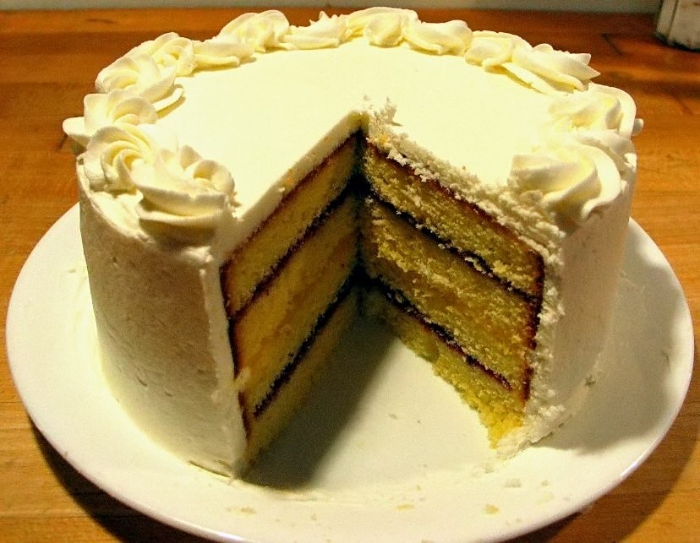
What about our cake?
Source: Wikipedia (Cake)

Slide 40
Hybrid Online/Batch Processing
Example: count historical clicks and clicks in real time
Kafka
Online processing
Online results
client
online
merging
batch
HDFS
Batch processing
Batch results

Slide 41
Hybrid Online/Batch Processing
Example: count historical clicks and clicks in real time
Kafka
read
Storm topology
write
Online results
query
client
online
client library
batch
Hadoop job
Batch results
query
ingest
HDFS
read
write
source₁
source₂
source₃
…
store₁
store₂
store₃
…

Slide 42
λ
(I hate this.)

Slide 43
Hybrid Online/Batch Processing
Example: count historical clicks and clicks in real time
Kafka
read
Storm topology
write
Online results
query
client
online
This is nuts!
client library
batch
Hadoop job
Batch results
query
ingest
Can we do better?
HDFS
read
write
source₁
source₂
source₃
…
store₁
store₂
store₃
…

Slide 44

Summingbird
A domain-specific language (in Scala) designed
to integrate batch and online MapReduce computations
Idea #1: Algebraic structures provide the basis for seamless integration of batch and online processing
Idea #2: For many tasks, close enough is good enough
Probabilistic data structures as monoids
Boykin, Ritchie, O’Connell, and Lin. Summingbird: A Framework for Integrating
Batch and Online MapReduce Computations. PVLDB 7(13):1441-1451, 2014.

Slide 45
Batch and Online MapReduce
“map”
flatMap[T, U](fn: T => List[U]): List[U]
map[T, U](fn: T => U): List[U]
filter[T](fn: T => Boolean): List[T]
“reduce”
sumByKey

Slide 46
Idea #1: Algebraic structures provide the basis for seamless integration of batch and online processing
Semigroup = ( M , ⊕ )
⊕ : M x M → M, s.t., ∀m₁, m₂, m₃ ∋ M
(m₁ ⊕ m₂) ⊕ m₃ = m₁ ⊕ (m₂ ⊕ m₃)
Monoid = Semigroup + identity
ε s.t., ε ⊕ m = m ⊕ ε = m, ∀m ∋ M
Commutative Monoid = Monoid + commutativity
∀m₁, m₂ ∋ M, m₁ ⊕ m₂ = m₂ ⊕ m₁
Simplest example: integers with + (addition)

Slide 47
Idea #1: Algebraic structures provide the basis for seamless integration of batch and online processing
Summingbird values must be at least semigroups (most are commutative monoids in practice)
Power of associativity =
You can put the parentheses anywhere!
( a ⊕ b ⊕ c ⊕ d ⊕ e ⊕ f )
Batch = Hadoop
((((( a ⊕ b ) ⊕ c ) ⊕ d ) ⊕ e ) ⊕ f )
Online = Storm
(( a ⊕ b ⊕ c ) ⊕ ( d ⊕ e ⊕ f ))
Mini-batches
Results are exactly the same!

Slide 48
Summingbird Word Count
where data comes from
def wordCount[P <: Platform[P]]
(source: Producer[P, String],
store: P#Store[String, Long]) =
source.flatMap { sentence =>
toWords(sentence).map(_ -> 1L)
}.sumByKey(store)
where data goes
“map”
“reduce”
Run on Scalding (Cascading/Hadoop)
read from HDFS
Scalding.run {
wordCount[Scalding](
Scalding.source[Tweet]("source_data"),
Scalding.store[String, Long]("count_out")
)
}
write to HDFS
Run on Storm
Storm.run {
wordCount[Storm](
new TweetSpout(),
new MemcacheStore[String, Long]
)
}
read from message queue
write to KV store

Slide 49
Input
Input
Input
Spout
Map
Map
Map
Bolt
Bolt
Bolt
Reduce
Reduce
Bolt
Bolt
Output
Output
memcached

Slide 50
“Boring” monoids
addition, multiplication, max, min
moments (mean, variance, etc.)
sets
tuples of monoids
hashmaps with monoid values
More interesting monoids?

Slide 51
“Interesting” monoids
Bloom filters (set membership)
HyperLogLog counters (cardinality estimation)
Count-min sketches (event counts)
Idea #2: For many tasks, close enough is good enough!

Slide 52
Cheat Sheet
Exact
Approximate
Set membership
set
Bloom filter
Set cardinality
set
hyperloglog counter
Frequency count
hashmap
count-min sketches

Slide 53
Example: Count queries by hour
Exact with hashmaps
def wordCount[P <: Platform[P]]
(source: Producer[P, Query],
store: P#Store[Long, Map[String, Long]]) =
source.flatMap { query =>
(query.getHour, Map(query.getQuery -> 1L))
}.sumByKey(store)
Approximate with CMS
def wordCount[P <: Platform[P]]
(source: Producer[P, Query],
store: P#Store[Long, SketchMap[String, Long]])
(implicit countMonoid: SketchMapMonoid[String, Long]) =
source.flatMap { query =>
(query.getHour,
countMonoid.create((query.getQuery, 1L)))
}.sumByKey(store)

Slide 54
Hybrid Online/Batch Processing
Example: count historical clicks and clicks in real time
Kafka
read
Storm topology
write
Online results
query
client
Summingbird
program
online
client library
batch
Hadoop job
Batch results
query
ingest
HDFS
read
write
source₁
source₂
source₃
…
store₁
store₂
store₃
…

Slide 55
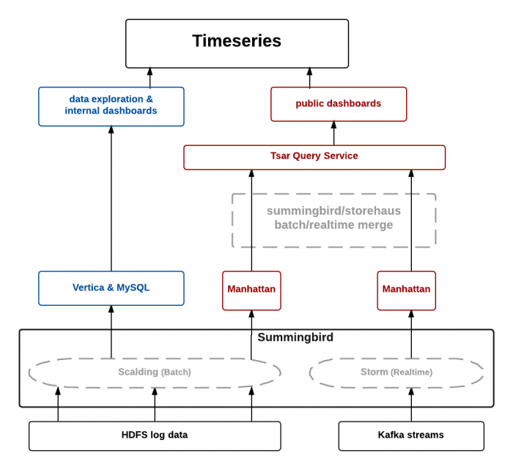
TSAR, a TimeSeries AggregatoR!
Source: https://blog.twitter.com/2014/tsar-a-timeseries-aggregator

Slide 56
Hybrid Online/Batch Processing
Example: count historical clicks and clicks in real time
Kafka
Online processing
Online results
client
Summingbird
program
online
merging
batch
HDFS
Batch processing
Batch results
But this is still too painful...

Slide 57
Hybrid Online/Batch Processing
Example: count historical clicks and clicks in real time
Kafka
Online processing
Online results
client
Wait, but how can this work?
Idea: everything is streaming
Batch processing is just streaming through a historic dataset!

Slide 58
Everything is Streaming!
Kafka
Kafka
Streams
Results
client
Cut out the middleman!
StreamsBuilder builder = new StreamsBuilder();
KStream<String, String> textLines = builder.stream("TextLinesTopic");
KTable<String, Long> wordCounts = textLines
.flatMapValues(textLine ->
Arrays.asList(textLine.toLowerCase().split("\\W+")))
.groupBy((key, word) -> word)
.count(Materialized.<String, Long,
KeyValueStore<Bytes, byte[]>>as("counts-store"));
wordCounts.toStream().to("WordsWithCountsTopic",
Produced.with(Serdes.String(), Serdes.Long()));
KafkaStreams streams = new KafkaStreams(builder.build(), config);
streams.start();

Slide 59
κ
(I hate this too.)

Slide 60
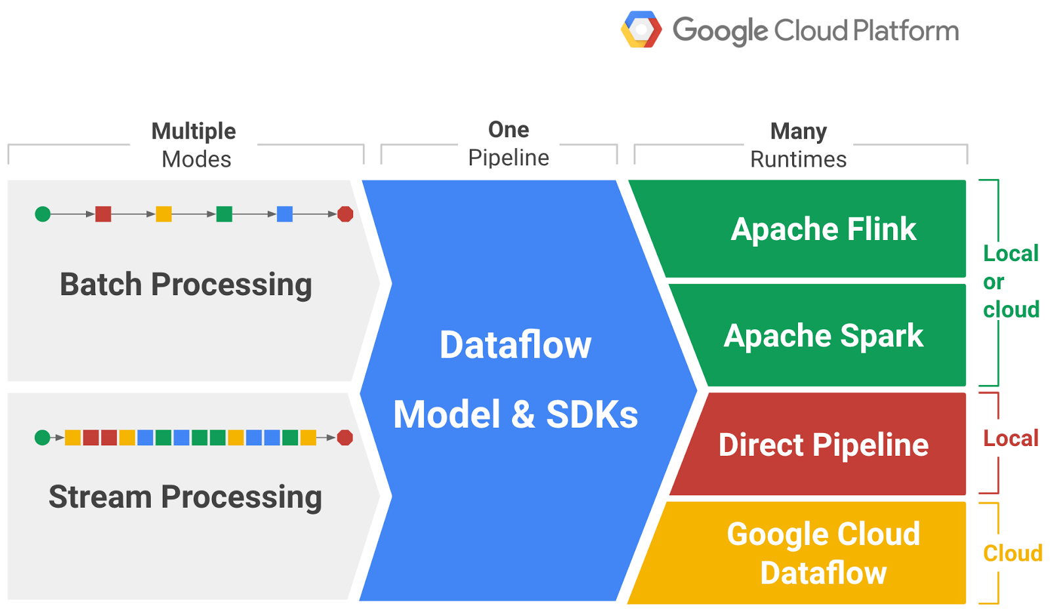
The Vision
Source: https://cloudplatform.googleblog.com/2016/01/Dataflow-and-open-source-proposal-to-join-the-Apache-Incubator.html

Slide 61
Processing Bounded Datasets
Pipeline p = Pipeline.create(options);
p.apply(TextIO.Read.from("gs://your/input/"))
.apply(FlatMapElements.via((String word) ->
Arrays.asList(word.split("[^a-zA-Z']+"))))
.apply(Filter.by((String word) -> !word.isEmpty()))
.apply(Count.perElement())
.apply(MapElements.via((KV<String, Long> wordCount) ->
wordCount.getKey() + ": " + wordCount.getValue()))
.apply(TextIO.Write.to("gs://your/output/"));

Slide 62
Processing Unbounded Datasets
Pipeline p = Pipeline.create(options);
p.apply(KafkaIO.read("tweets")
.withTimestampFn(new TweetTimestampFunction())
.withWatermarkFn(kv ->
Instant.now().minus(Duration.standardMinutes(2))))
.apply(Window.into(FixedWindows.of(Duration.standardMinutes(2)))
.triggering(AtWatermark()
.withEarlyFirings(AtPeriod(Duration.standardMinutes(1)))
.withLateFirings(AtCount(1)))
.accumulatingAndRetractingFiredPanes())
.apply(FlatMapElements.via((String word) ->
Arrays.asList(word.split("[^a-zA-Z']+"))))
.apply(Filter.by((String word) -> !word.isEmpty()))
.apply(Count.perElement())
.apply(KafkaIO.write("counts"))
Where in event time?
When in processing time?
How do refines relate?

Slide 63

Source: flickr (https://www.flickr.com/photos/39414578@N03/16042029002)

